Slide 1
Introduction to Galaxy
Day 1 Afternoon
Emily Chambers
Notes:
<number>

Slide 2
Outcomes
The goals of this session are:
Introduce you to the galaxy server
To introduce you to the gnomad browser.
To introduce you to the UCSC table browser
To encourage you to explore Galaxy on your own.

Slide 3
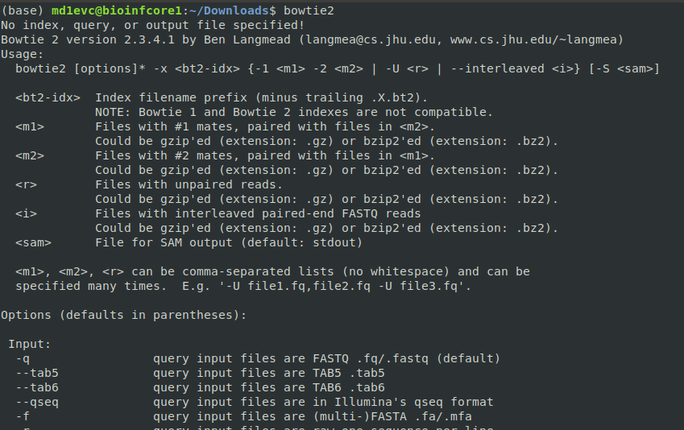
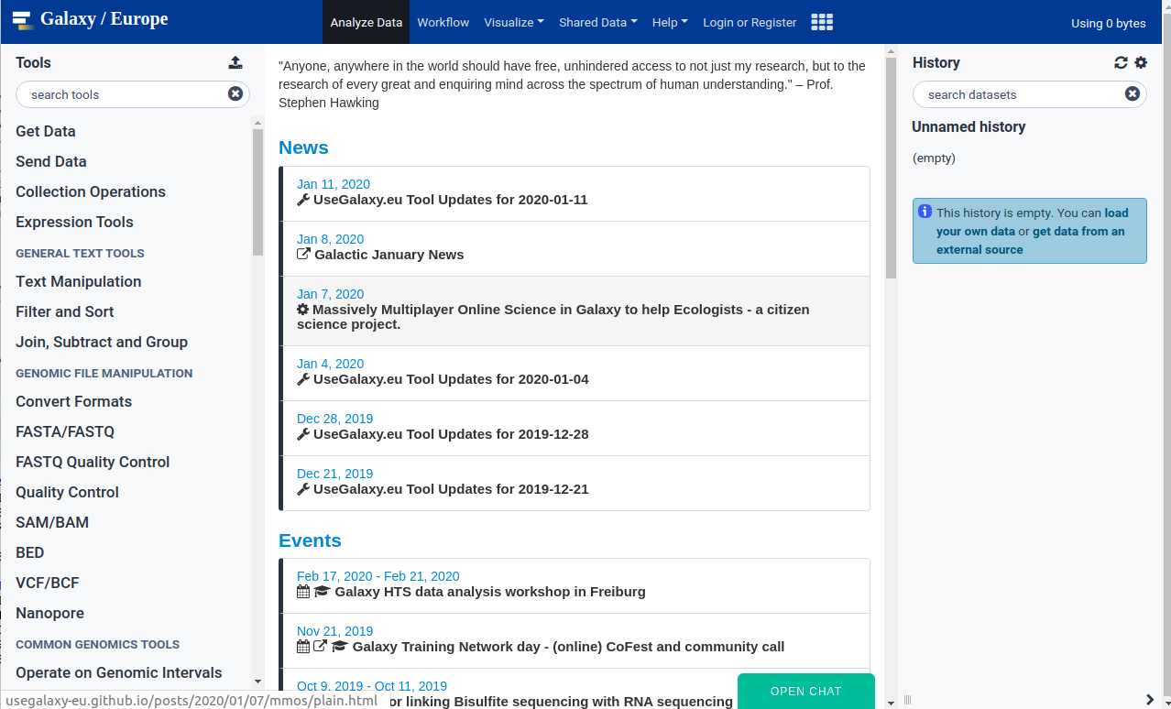
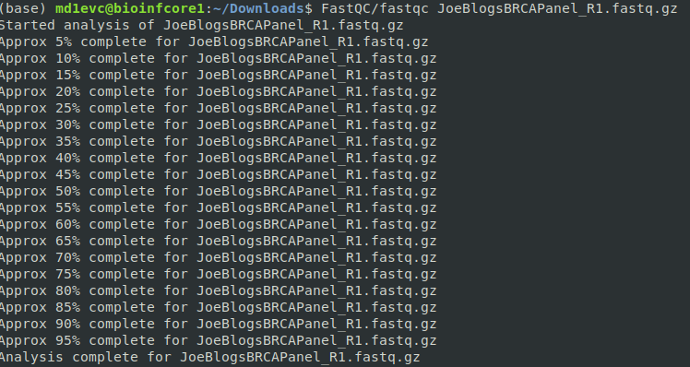
What is Galaxy?
GOOD
NOT GOOD
All in one pipeline
Easy to use interface
Good introduction to widely used bioinformatics tools
No programming knowledge needed
Reliant on external servers
Struggles with large files
Not as flexible
Slow

Slide 4
Galaxy - https://usegalaxy.eu/

Slide 5
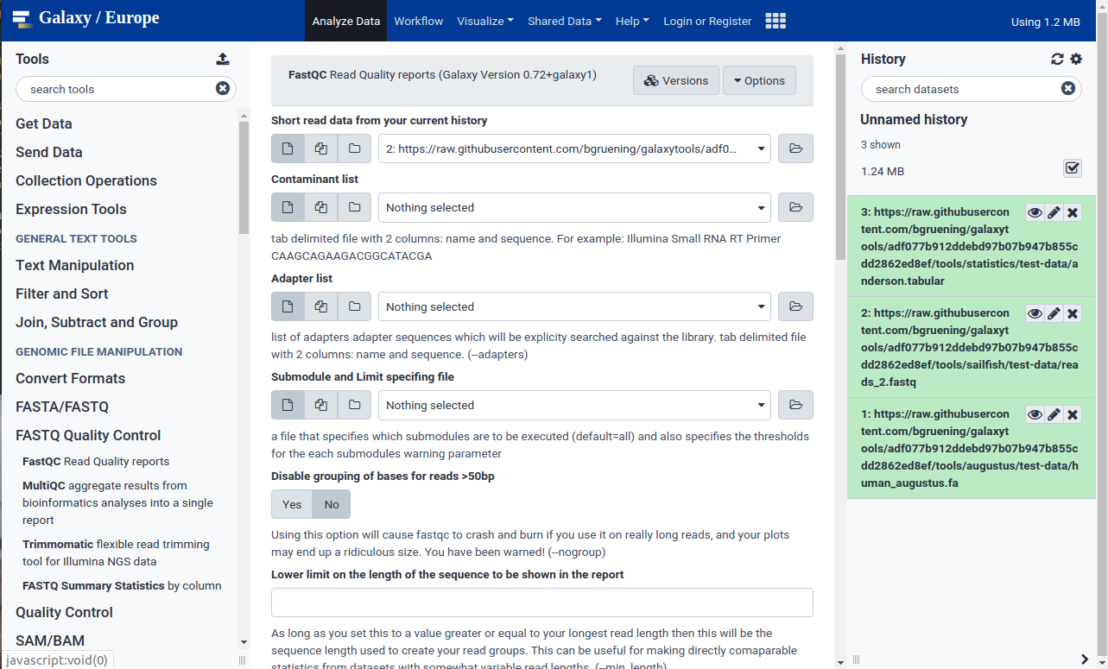
Galaxy – take a look around
Main page for selected tool showing more information and parameters
Workflow history – all files created so far
Tools – arranged into categories

Slide 6
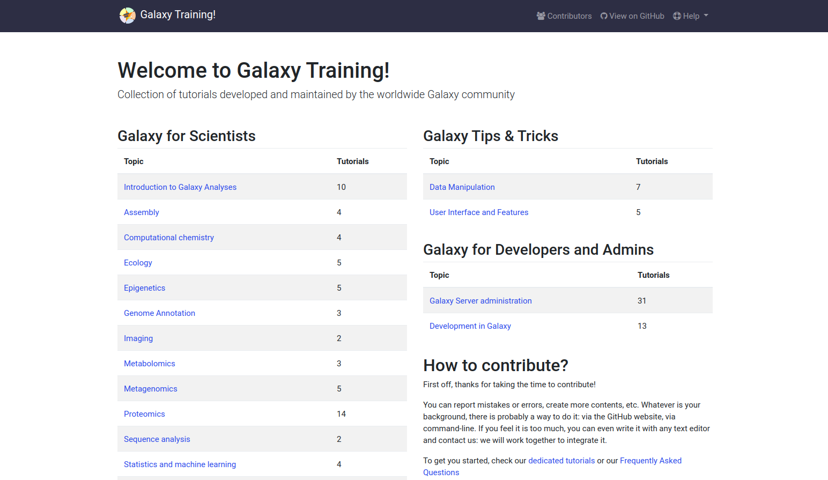
Galaxy training - https://training.galaxyproject.org/

Slide 7
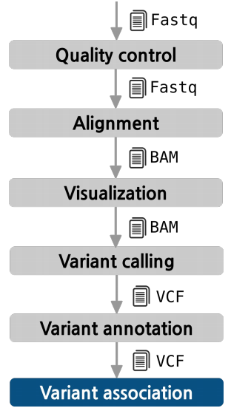
1
The Pipeline
FastQC
Bowtie
You are here!
Galaxy
IGV
FreeBayes
ANNOVAR
External Data
Report
ACMG
Guidelines
Variant interpretation

Slide 8
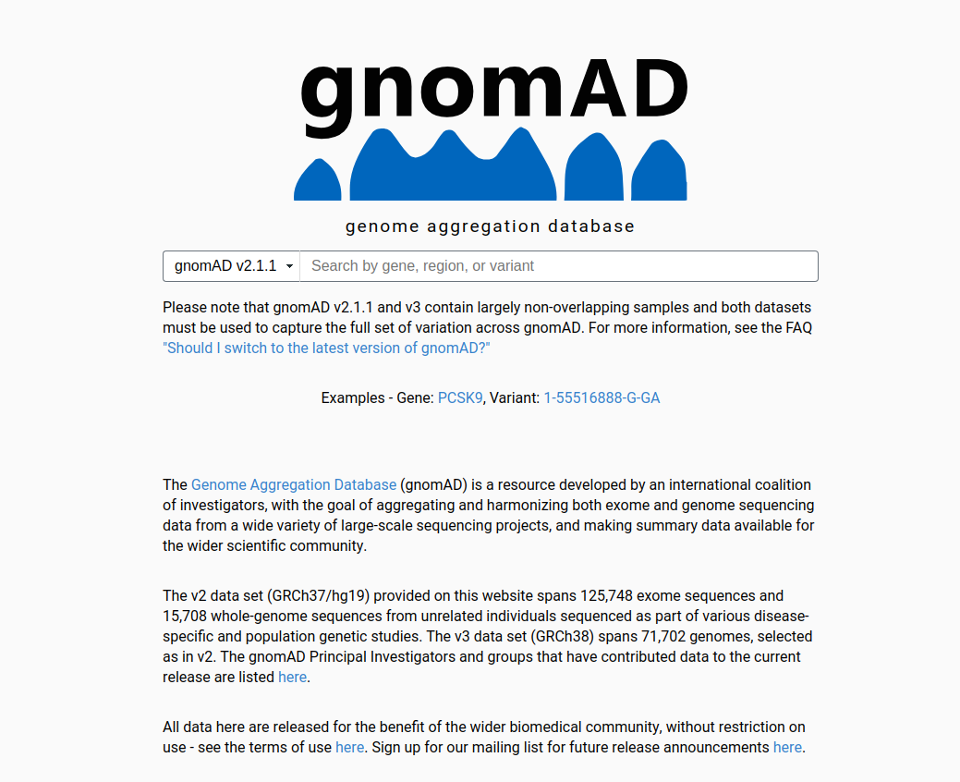
Data resources – gnomAD
Genome Aggregation Database (gnomAD) – a collection of large-scale, disease-specific and population genetic sequencing projects.
gnomAD allows visualizing data, but does not do complex analysis.
You can use it to quickly access genetic data and to validate information retrieved from other tools like Galaxy.

Slide 9
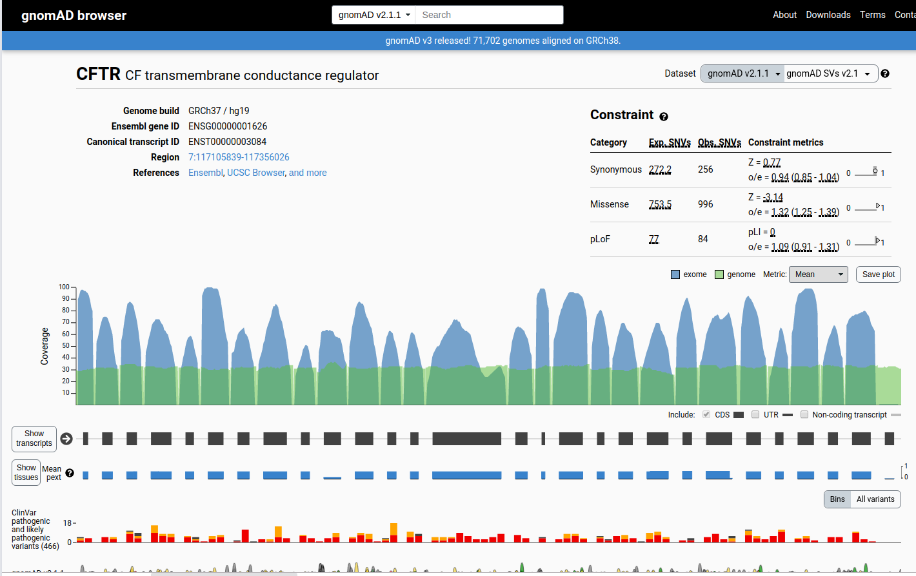
https://gnomad.broadinstitute.org/

Slide 10
Exercise – explore gnomad
Examine the OCA2 gene.
How many transcripts does it have ?
How many Synonymous variants?
How many predicted loss-of-function (pLoF) variants?
How many stop gained LoF variants? (Hint – export the variants to csv!)
What is the role of this gene? (Hint – look up the reference links)
Do the same for MC1R and HERC2

Slide 11
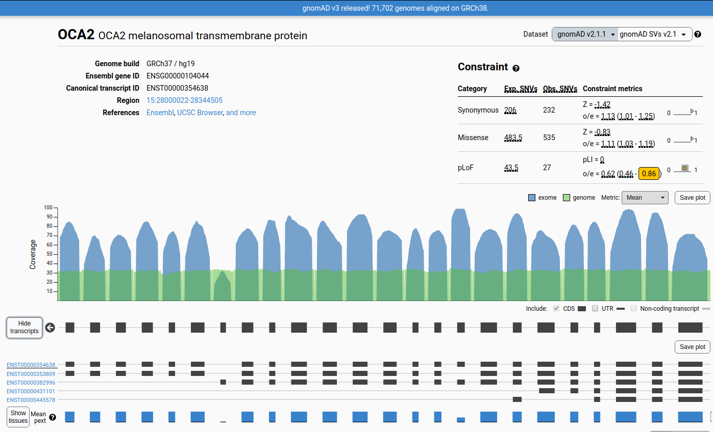
Answers
Number of synonymous variants
Gene information
Number of pLOF variants
Number of transcripts

Slide 12
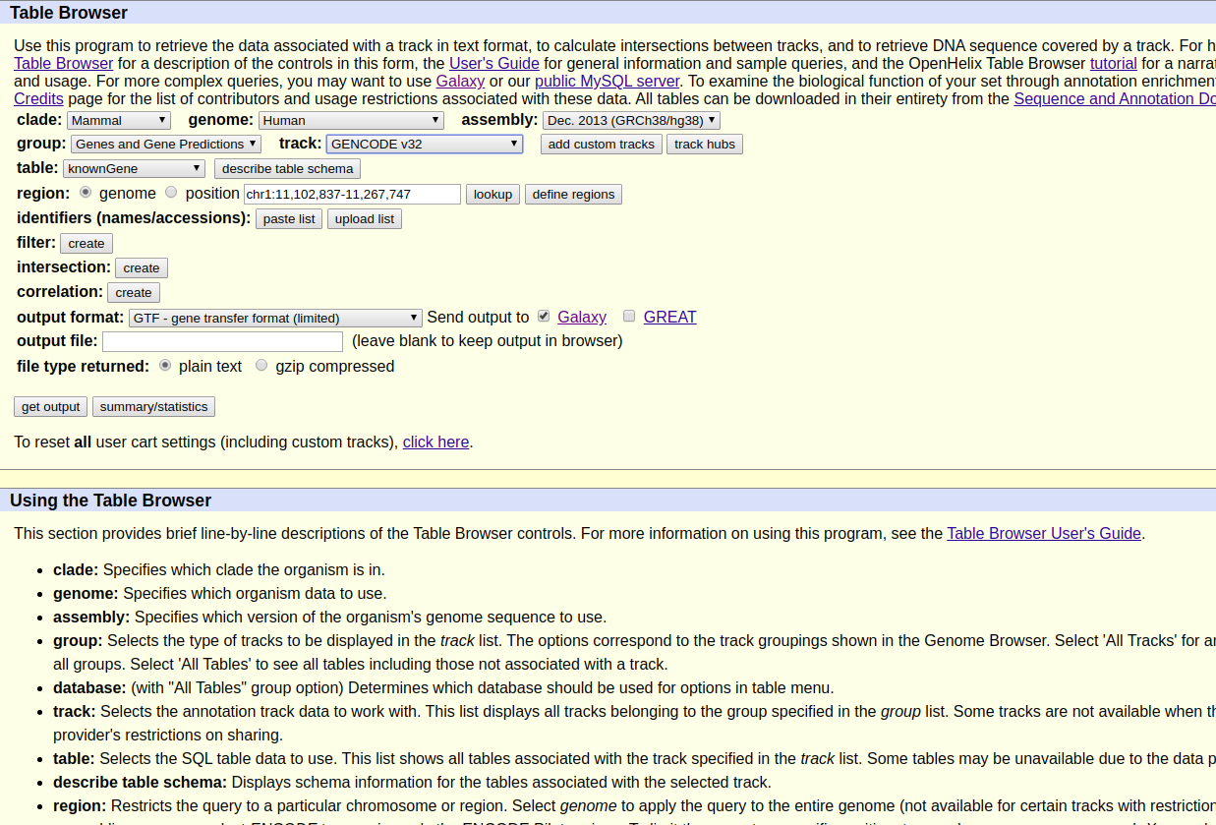
UCSC table browser -https://genome.ucsc.edu/

Slide 13
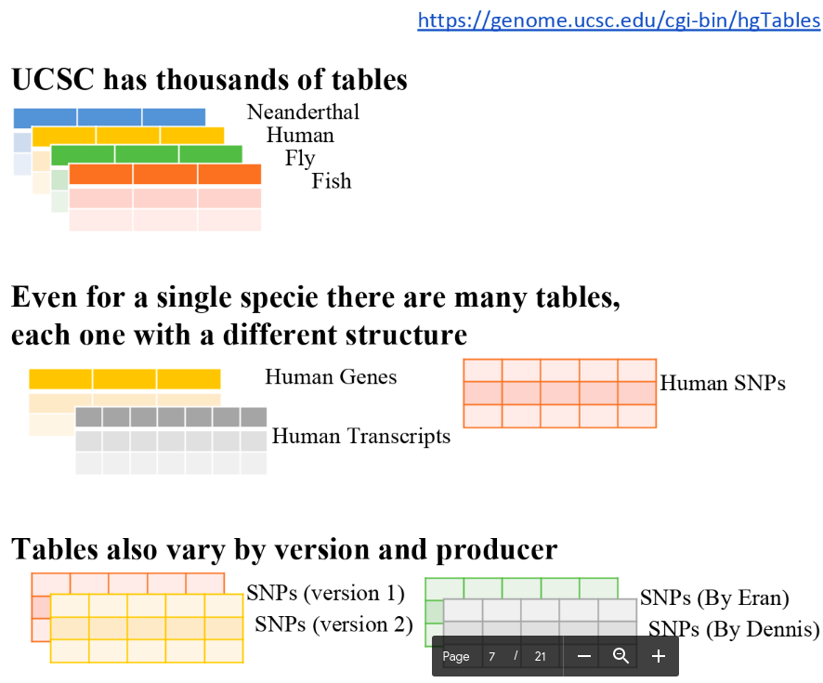
UCSC table browser

Slide 14
We can export any table we want to galaxy!
UCSC table browser
Choose proper filters (species and function).
Species: Clade (mammals) -> genome (human) -> assembly (genome version)
Function: group (gene/variation) -> track (table producer) -> table
Help on each option found here

Slide 15
Exercise - Import a UCSC table to Galaxy
Go to galaxy - https://usegalaxy.eu/
Go to get data – UCSC Main table browser
Import the NCBI RefSeq gene table for the latest human genome assembly. The table name is RefSeq All (ncbiRefSeq)
Look up the describe table schema option – gives useful information on the file to be imported.
Use get output when ready to import to galaxy
Use the eye icon in your workflow to examine the data

